Slide 1
Week 6
EER Diagrams – Mapping the EER diagram to relational tables

Slide 2
Student Objectives
Upon completion of this video, you should be able to:
Given an EER diagram, convert it to relational tables using one of the four rules.

Slide 3
Mapping EER Diagrams to Relations:
In Lecture 2, we introduced 7 steps to convert an ER diagram to a relational database, now we add Step 8:
Step 8: Convert each specialization with m subclasses {S₁, S₂, … S_{m}} and (generalized) superclass C, where the attributes of C are {k, a₁, … ,a_{n}} and k is the (primary) key, into relations schemes using one of the four following options:

Slide 4
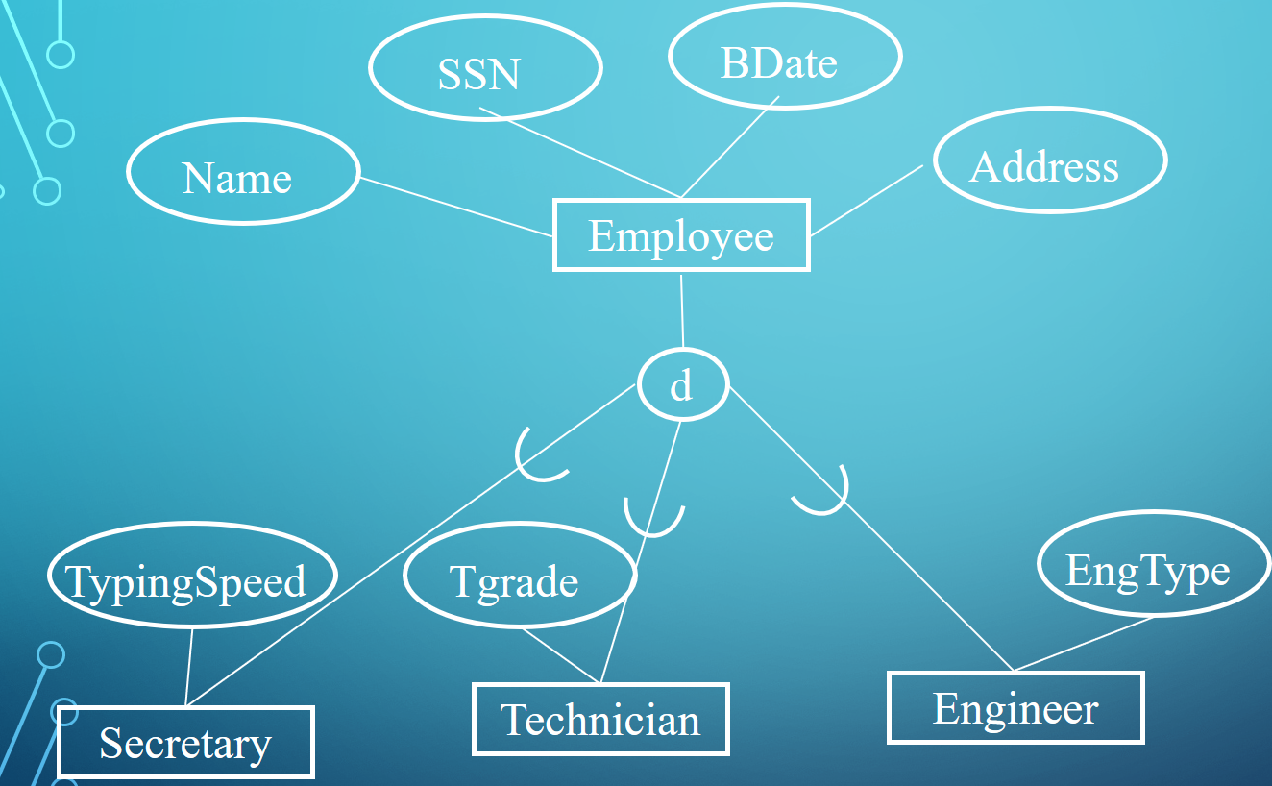
Option 8A Multiple relations – superclass and subclasses: Create a relation L for C (superclass) with attributes = {k, a₁, … ,a_{n}} and primary key = k. Create a relation L_{i} for each subclass S_{i}, 1 <= i <= m, with the attributes of L_{i} = {k} U {attributes of S_{i}}, and primary key of L_{i} = k.
Employee
SSN | Name | Bdate | Address | JobType
22 | Homer Smith | 2/2/1970 | Springfield | Tec
33 | Lisa Jones | 1/1/90 | London | Eng
34 | Bob Lee | 4/4/91 | London | Eng
56 | Laura Cook | 2/19/64 | London | Sec
JobType
Secretary
Technician
SSN | TypingSpeed
56 | 60
SSN | Tgrade
22 | Tgrade7
Engineer
SSN | EngType
33 | Civil
34 | Chemical

Slide 5
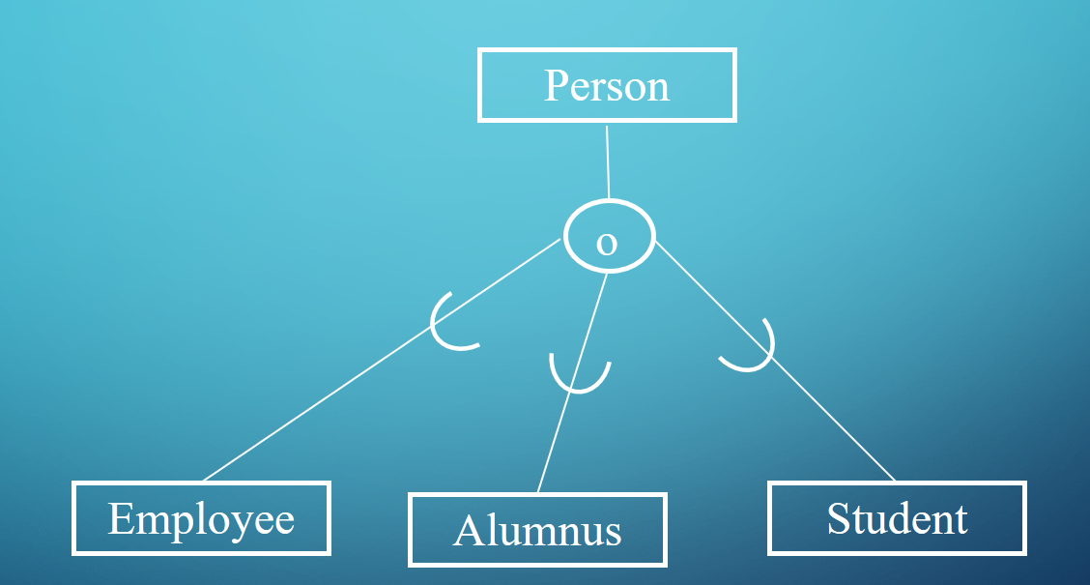
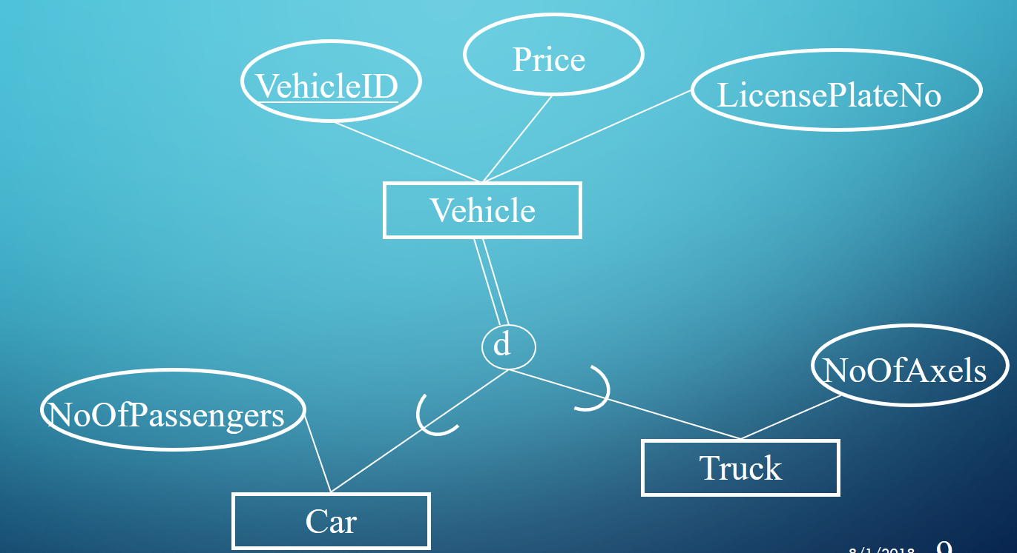
Option 8B Multiple relations – subclass relations only: Create a relation L_{i} for each subclass S_{i}, 1 <= i <= m, with the attributes {attributes of S_{i}} U {k, a₁, … ,a_{n}} and primary key for each L_{i} = k. (i.e. do not have a relations for C (superclass) ).
Only works for when the specialization is TOTAL
Recommended only for disjoint, with overlapping the same entity may be duplicated→ REDUNDANCY!
Car
VehicalID | LicPlateNo | Price | NumOfPass
13 | BKJH 310 | 20,900 | 2
31 | AJH 111 | 41,000 | 7
33 | BWLK 315 | 15,999 | 5
Truck
VehicalID | LicPlateNo | Price | NumOfAxel
15 | BKKK 310 | 64,900 | 3
44 | AAAA 111 | 45,000 | 2
Employee
Alumni
FirstName | LastName | SSN | Salary
Laura | Reid | 111 | 4000.00
Sue | Smith | 121 | 3000.00
FirstName | LastName | SSN | Degree
Laura | Reid | 111 | MSc

Slide 6
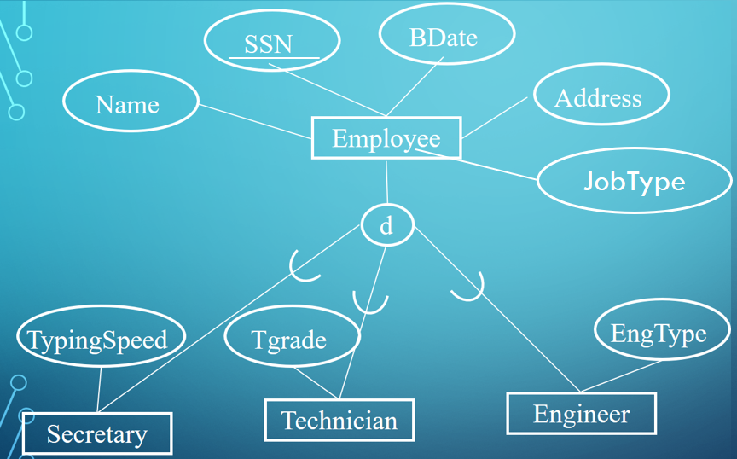
Option 8C Single relation with one type attribute: Create a single relation L with attributes {k, a₁, … ,a_{n}} U {attributes of S₁} U … U {attributes of S_{m}} and primary key = k.
This option is for disjoint subclasses, with a discriminating attribute or category, and has the potential for generating a large number of null values.
Employee
SSN | Name | Bdate | Address | JobType | TypingSpeed | Tgrade | EngType
22 | Homer Smith | 2/2/1970 | Springfield | Tec | Null | Tgrade7 | Null
33 | Lisa Jones | 1/1/90 | London | Eng | Null | Null | Civil
34 | Bob Lee | 4/4/91 | London | Eng | Null | Null | Chemical
56 | Laura Cook | 2/19/64 | London | Sec | 60 | Null | Null

Slide 7
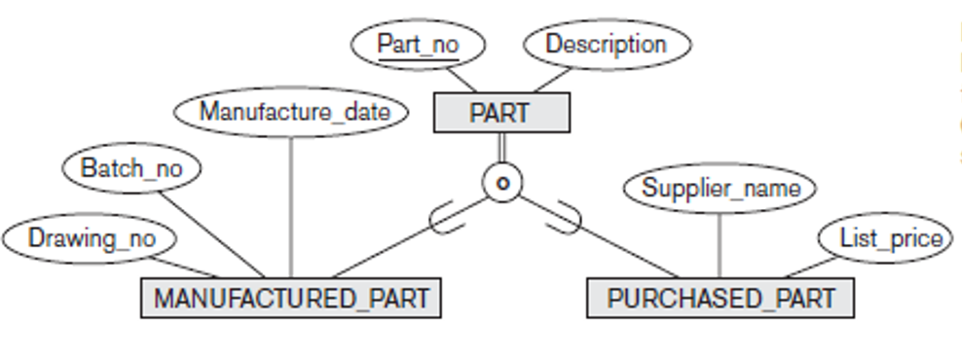
Option 8D Single relation with multiple type attributes: Create a single relation L with attributes {k, a₁, … ,a_{n}} U {attributes of S₁} U … U {attributes of S_{m}} U {t₁, t₂, …, t_{m}} with primary key k.
This option is for overlapping subclasses, and each t_{i}, 1 <= i <= m, is a Boolean attribute indication whether this tuple belongs to subclass S_{i}.
Part
PartNo | Descrip | Mflag | DrawingNo | BatchNo | ManufDate | Pflag | Supplier_Name | ListPrice
111 | Screw | True | 6758 | A3 | 2/2/2018 | False | Null | Null
222 | Hammer | False | Null | Null | Null | Null | Rona | 45.00
333 | Drill | True | 8765 | A7 | 1/1/2018 | True | Home Hardware | 129.00

Slide 8
Another Example:
City Hall is trying to classify it's buildings for taxing purposes.
Every building has an address and a unique building code and the owners name.
A building must be either a private residence or business, but it cannot be both.
For a private residences, city hall wants to also keep track of the number of bedrooms and number of bathrooms.
For a business, they want to keep track of the number of exits, size of the property, and the number of parking spots.

Slide 9
QUESTION: Draw an EER diagram to reflect this example:
BuildingCode
OwnerName
Address
Building
d
NumOfParkingSpots
NumOfExits
NumOfBedrooms
NumOfBathrooms
BusinessBuilding
PrivateResidence
Size

Slide 10
Map your EER diagram to relational table(s):
BusinessBuilding
BuildingCode | OwnerName | Address | Size | NumOfParkingSpots | NumOfExits
PrivateResidence
BuildingCode | OwnerName | Address | NumOfBedrooms | NumOfBathrooms

